Slide 1

PYTHON MINI PROJECT BASED ON OOPS CONCEPT
Employee Record Management System
A console-based Python application demonstrating Object-Oriented Programming principles to manage employee data efficiently.
Presented By:
Department:
Institution
ARTIFICIAL INTELLIGENCE AND DATA SCIENCE
JJCET
DAARANI B
811324243024

Slide 2
Project Overview
A lightweight, console-based application built in Python that leverages core OOP principles to manage employee records with speed and clarity.
Console-Based
OOP-Driven
Operates through a clean command-line interface for direct interaction.
Built entirely on Object-Oriented Programming concepts for modularity.
Dictionary Storage
File Persistence
Fast record lookup using Python dictionaries indexed by Employee ID.
Saves all records to a text file for permanent, portable storage.

Slide 3
Project Objectives
1
Add Employee Records
Register new employees with key details like name, salary, and experience.
2
View All Employees
Display all stored records in a structured, readable format.
3
Search Employees
Quickly locate an employee by ID using dictionary-based lookup.
4
Update Details
Modify existing employee information with accurate field targeting.
5
Delete Records
Remove obsolete entries while maintaining data integrity.
6
Generate Reports
Produce insights like highest salary and experienced employees.
7
Permanent Storage
Persist all records to a text file for session continuity.

Slide 4
Project Structure
The project is organized into modular Python files, each handling a specific concern to ensure maintainability and clean separation of responsibilities.
File Name
Purpose
employee.py
Defines the abstract Employee class and its subclasses with OOP structure.
employee_manager.py
Manages all CRUD operations using an Employee ID-key dictionary.
report.py
Generates analytical reports like highest salary and experienced lists.
file_handler.py
Handles saving and loading records to and from the data.txt file.
main.py
Entry point displaying the menu and routing user selections.
data.txt
Text-based storage file persisting employee records across sessions.

Slide 5
System Features
The system provides a comprehensive set of operations for full employee lifecycle management.
Add Employee
Search Employee
Delete Record
Experienced Staff
Remove outdated entries from the system.
Filter employees meeting a defined experience threshold.
Register new staff with ID, name, salary, and type.
Find any record instantly by Employee ID.
View Employees
Update Details
Highest Salary
Save to File
Identify the top-earning employee across records.
Identify the top-earning employee across records.
Persist all current data to data.txt permanently.
List all stored records in one consolidated view.
Edit existing employee fields with precision.

Slide 6
OOP Concepts Used
The project comprehensively demonstrates major Object-Oriented Programming principles through practical implementation.
Concept
Usage in Project
Class
Employee, EmployeeManager, Report, and FileHandler classes define structure.
Object
Employee objects are instantiated for each staff member.
Constructor
Initializes employee details automatically upon creation.
Encapsulation
Private variables accessed through getters and setters.
Inheritance
Permanent, Contract, and Intern classes derive from Employee.
Abstraction
work_mode() and calculate_bonus() declared abstract in parent.
Polymorphism
Same method behaves differently for each employee type.
Dictionary
Stores records keyed by Employee ID for fast retrieval.
File Handling
Writes and reads records from a persistent text file.

Slide 7

Class Hierarchy
Supporting Classes
ContractEmployee & Intern
Contracted hours and internship rules
EmployeeManager
PermanentEmployee
Coordinates all CRUD operations and in-memory storage.
Full-time; salary and bonus logic
Employee (Abstract)
Defines shared interface and behaviors
Report
Generates analytical reports on demand.
The Employee base class defines the shared interface, while PermanentEmployee, ContractEmployee, and InternEmployee provide specialized implementations for bonus calculation and work mode.
FileHandler
Persists records to and loads from data.txt.

Slide 8
Tool / Technology | Purpose
Python | Programming Language
Visual Studio Code | Code Editor
Object-Oriented Programming | Application Design
Dictionary | In-memory Data Storage
File Handling | Store Employee Records
Text File (.txt) | Persistent Data Storage
Git & GitHub (Optional) | Version Control

Slide 9
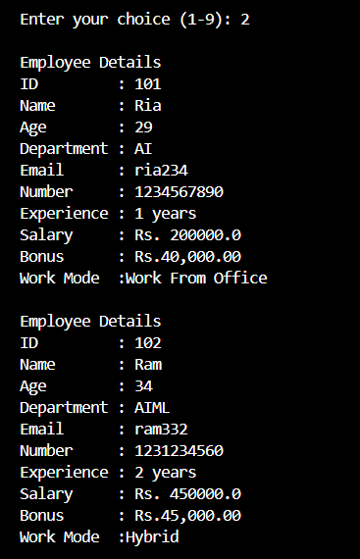
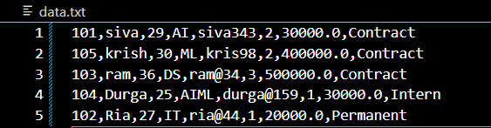
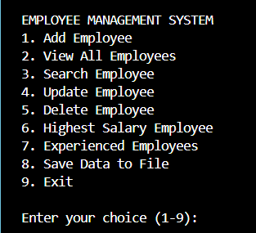
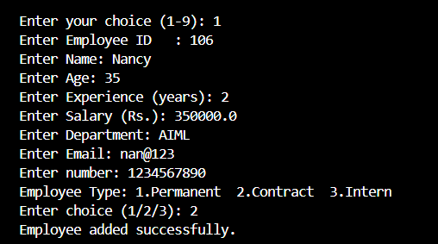
Sample Console Output
Representative console interactions showing key system operations in action.
STORED DATA
ADD DETAILS
MAIN MENU
VIEW ALL

Slide 10

Advantages
Key Advantages
Future Enhancements
Simple console-based interface.
Fast dictionary-powered search by Employee ID.
Modular file structure for easy maintenance.
Demonstrates all major OOP principles.
Reusable and extensible codebase.
Login authentication for secure access.
MySQL database integration for scalability.
Employee attendance and leave management.
Salary slip generation and data dashboards.
The project successfully demonstrates CRUD operations, inheritance, polymorphism, and file handling — forming a strong foundation for a full-scale HR management system.

Slide 11
Conclusion
Developed a console-based Employee Record Management System using Python.
Successfully implemented CRUD operations for employee records.
Applied OOP concepts: Encapsulation, Inheritance, Abstraction, and Polymorphism.
Used dictionaries for efficient data management.
Implemented file handling for persistent data storage.
Designed a modular and easy-to-maintain project structure.
Provides a foundation for future enhancements such as databases, GUI, and authentication.

